Slide 1

7th Grade Math
Unit 4, Lesson 1 Deriving Area Formulas for Trapezoids, Parallelograms, and Rhombi Volume 1, pg. 125

Slide 2


Benchmark
MA.7.GR.1.1
Apply formulas to find the areas of trapezoids, parallelograms, and rhombi.
volume 1, pg. 125

Slide 3
Integrated Mathematical Thinking and Reasoning Standards
MA.K12.MTR.1.1 Actively participate in effortful learning both individually and collectively.
MA.K12.MTR.2.1 Demonstrate understanding by representing problems in multiple ways.
MA.K12.MTR.4.1 Engage in discussions that reflect on the mathematical thinking of self and others.
MA.K12.MTR.5.1 Use patterns and structure to help understand and connect mathematical concepts.
volume 1, pg. 125

Slide 4

Learning Target
I can use the formulas for the area of triangles and rectangles to derive formulas for the area of trapezoids, parallelograms, and rhombi.
volume 1, pg. 125

Slide 5

Warm-Up
volume 1, pg. 125

Slide 6
4.1.1 Warm-Up: Notice and Wonder
Two figures are shown.
Figure 1
Figure 2
What do you notice about these two figures?
What do you wonder about the figures?
volume 1, pg. 125
Notes:
Video Link: https://algebranation.wistia.com/medias/fi4fidi5y8

Slide 7

Refresher
volume 1, pg. 126

Slide 8

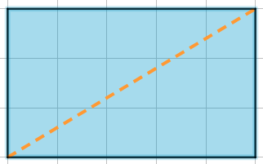
4.1.2 Refresher: Decomposing to Find the Area of a Triangle
Figures can be decomposed into smaller pieces that are then rearranged and composed into other shapes. Decomposing is useful when finding the area of a figure.
Complete the table.
The rectangle is divided into _____ triangles. The area of Triangle A is ____ of the area of the rectangle.
Triangle A
volume 1, pg. 126

Slide 9
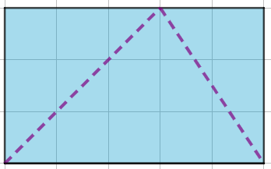
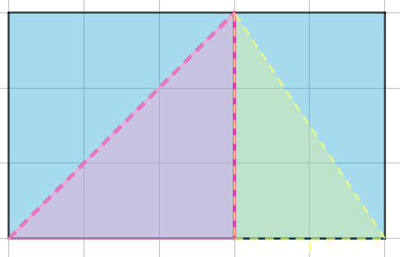
The rectangle is divided into _____ triangles. The area of Triangle B is ____ of the area of the rectangle. The area of Triangle C is ____ of the area of the rectangle.
The rectangle is divided into _____ triangles. The area of Triangle D is ____ of the area of the rectangle. The area of Triangle E is ____ of the area of the rectangle.
Triangle B
Triangle C
Triangle E
Triangle D
volume 1, pg. 126

Slide 10

Activity
volume 1, pg. 126

Slide 11


4.1.3 Activity: Deriving the Formula for the Area of a Parallelogram
A quadrilateral is a polygon with exactly four sides and four vertices.
A parallelogram is a type of quadrilateral. Not only does a parallelogram have four sides and four vertices, but its opposite sides are also parallel.
A parallelogram is a quadrilateral containing two pairs of parallel sides.
volume 1, pg. 126

Slide 12


A parallelogram is shown on a grid with each gridline representing one unit.
$$h$$
$$b$$
Complete each statement.
The base of the parallelogram is _____ units.
The height of the parallelogram is _____ units.
volume 1, pg. 127

Slide 13
The images below show the same parallelogram being decomposed and then rearranged to form a rectangle.
Complete each statement.
The base of the rectangle is _____ units.
The height of the rectangle is _____ units.
volume 1, pg. 127

Slide 14
Discuss with your partner the relationship between the area of the parallelogram and the area of the rectangle. Write a summary of your discussion.
volume 1, pg. 127

Slide 15
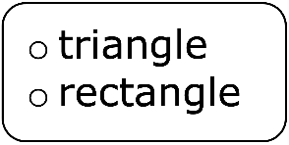
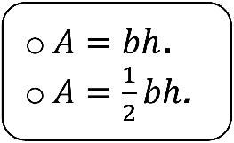
Complete the statements.
A parallelogram can be decomposed and
rearranged into a with the same
base and height. The formula used to find the
area of a rectangle is Therefore, the area of the parallelogram is
volume 1, pg. 127

Slide 16
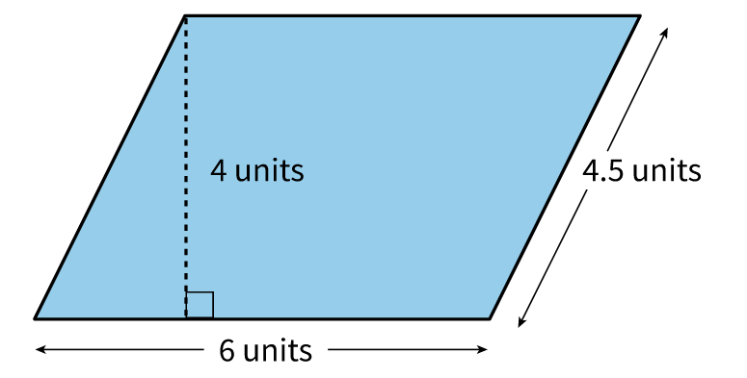
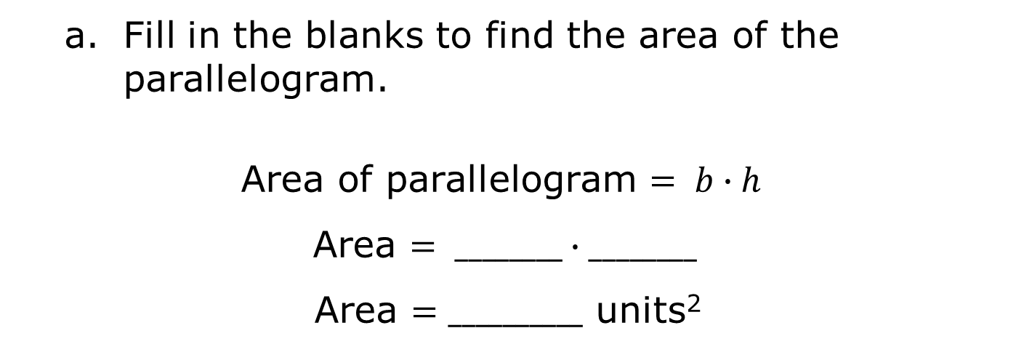
A parallelogram with its dimensions labeled is shown.
Fill in the blanks to find the area of the parallelogram.
Area of parallelogram $= b∙h$
Area $= ________∙________$
Area $=__________$ units²
volume 1, pg. 128

Slide 17
Three lengths are shown in the figure. With your partner, discuss the length that was not used to find the area of the parallelogram. Then, write an explanation for why this length was not used.
volume 1, pg. 128

Slide 18
Activity
volume 1, pg. 128

Slide 19
4.1.4 Activity: Deriving the Formula for the Area of a Trapezoid
A trapezoid is another type of quadrilateral.
A trapezoid is a quadrilateral with at least one pair of parallel sides.
Trapezoid A is shown on a grid with each gridline representing one unit.
Trapezoid A
volume 1, pg. 128

Slide 20
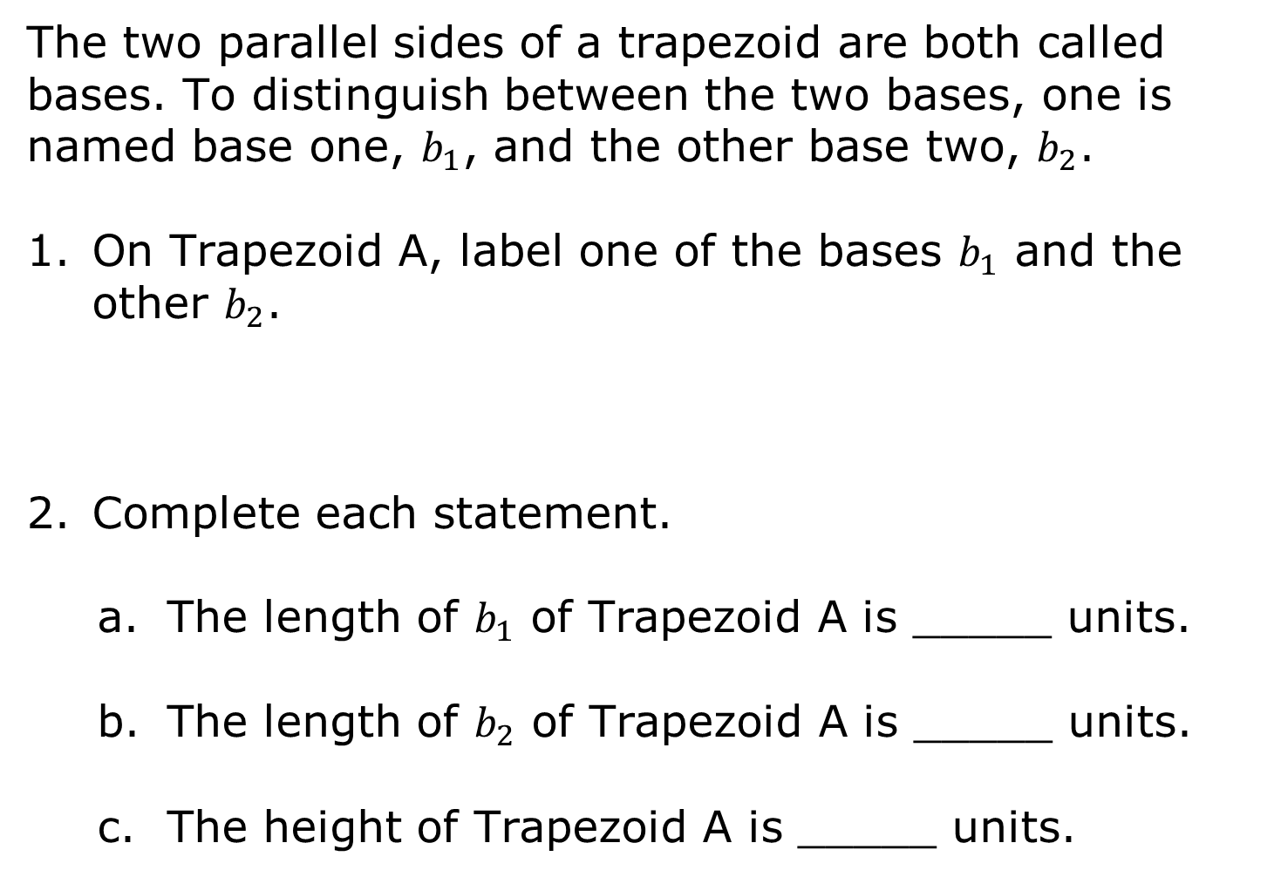
The two parallel sides of a trapezoid are both called bases. To distinguish between the two bases, one is named base one, $b_{1}$, and the other base two, $b_{2}$.
On Trapezoid A, label one of the bases $b_{1}$ and the other $b_{2}$.
Complete each statement.
The length of $b_{1}$ of Trapezoid A is _____ units.
The length of $b_{2}$ of Trapezoid A is _____ units.
The height of Trapezoid A is _____ units.
volume 1, pg. 128

Slide 21


Trapezoid A is decomposed into two triangles and labeled, as shown below.
Trapezoid A
$$b_{1}$$
Triangle M
Triangle T
$$b_{2}$$
volume 1, pg. 129

Slide 22
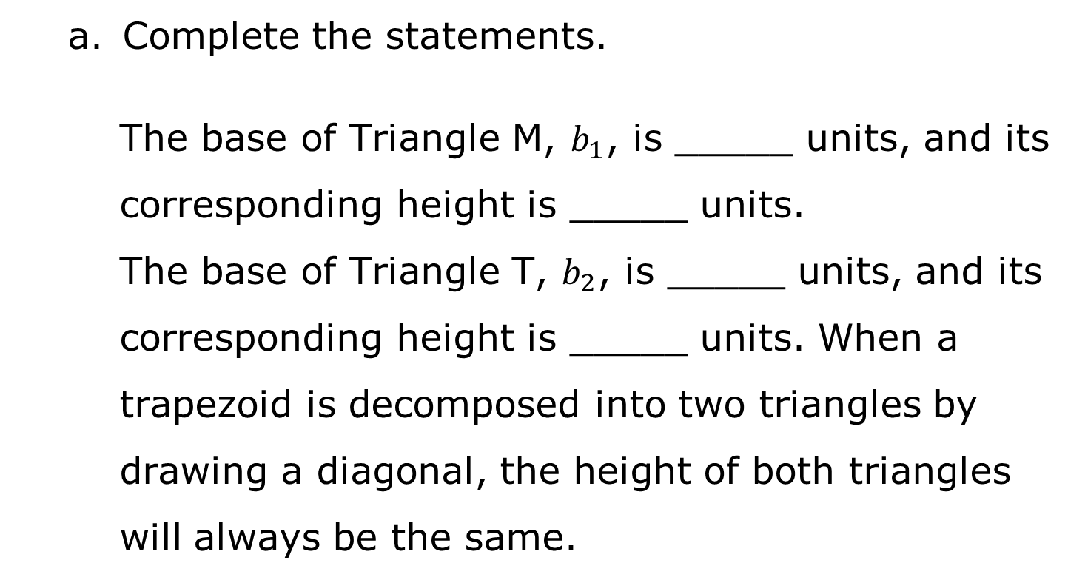
Complete the statements.
The base of Triangle M, $b_{1}$, is _____ units, and its corresponding height is _____ units.
The base of Triangle T, $b_{2}$, is _____ units, and its corresponding height is _____ units. When a trapezoid is decomposed into two triangles by drawing a diagonal, the height of both triangles will always be the same.
volume 1, pg. 129

Slide 23
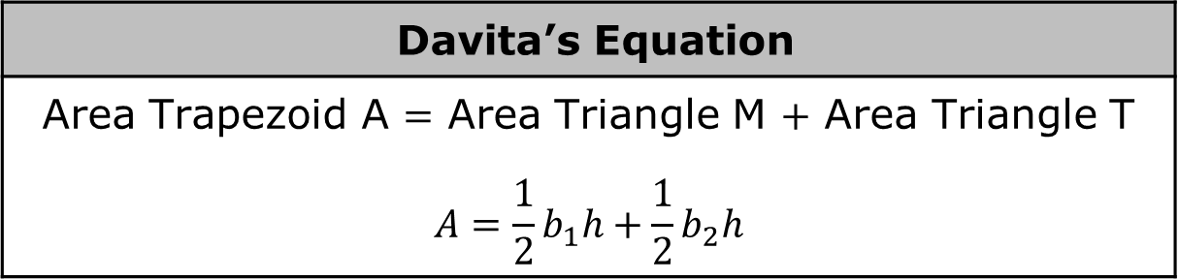
Davita wrote a formula for the area of Trapezoid A.
Davita’s Equation
Area Trapezoid A $=$ Area Triangle M $+$ Area Triangle T $$A=\frac{1}{2}b_{1}h+\frac{1}{2}b_{2}h$$
Explain how Davita determined this formula.
volume 1, pg. 129

Slide 24
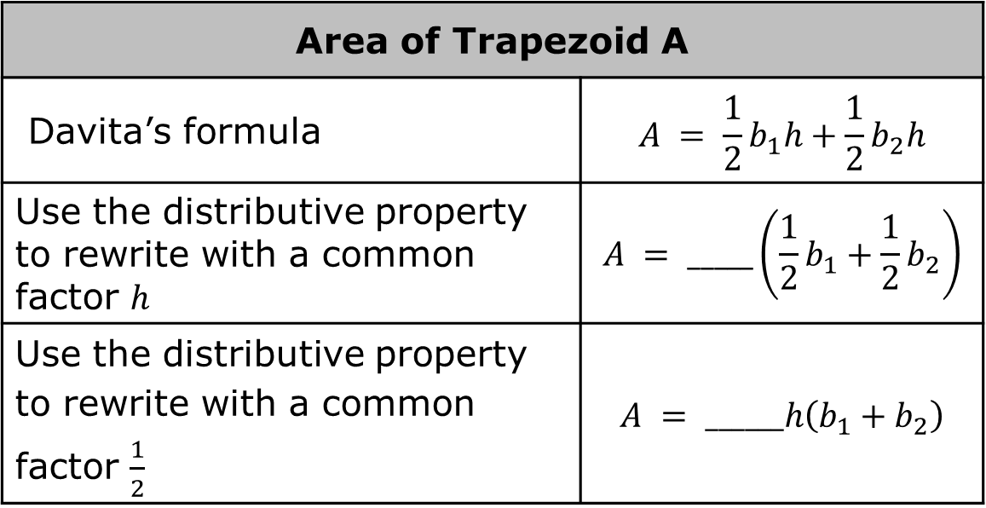
The formula Davita wrote can be used to find the area of any trapezoid. Complete the steps described in the table to rewrite the formula.
Area of Trapezoid A
Davita’s formula | $$A = \frac{1}{2}b_{1}h+\frac{1}{2}b_{2}h$$
Use the distributive property to rewrite with a common factor $h$ | $$A = _____\left(\frac{1}{2}b_{1}+\frac{1}{2}b_{2}\right)$$
Use the distributive property to rewrite with a common factor $\frac{1}{2}$ | $$A = ______h\left(b_{1}+b_{2}\right)$$
volume 1, pg. 129

Slide 25
Activity
volume 1, pg. 130

Slide 26





4.1.5 Activity: Deriving the Formula for the Area of a Rhombus
A rhombus is another type of quadrilateral.
A rhombus is a quadrilateral containing four sides of equal length.
Rhombus F is shown with four congruent sides.
Rhombus F
$$s$$
$$s$$
$$s$$
$$s$$
volume 1, pg. 130

Slide 27
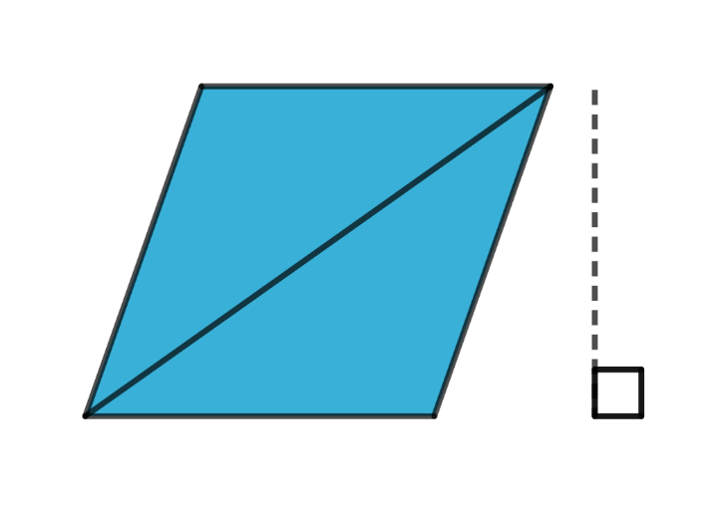



Rhombus F is decomposed into two triangles, Triangle X and Triangle Y, as shown.
Rhombus F
$$s$$
Triangle X
$$h$$
Triangle Y
$$s$$
volume 1, pg. 130

Slide 28
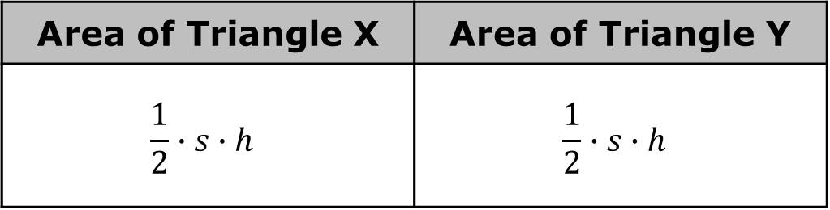
Felicia wrote expressions to represent the areas of the two triangles.
Area of Triangle X | Area of Triangle Y
$$\frac{1}{2}∙s∙h$$ | $$\frac{1}{2}∙s∙h$$
Discuss with your partner whether you agree with the expressions Felicia wrote. Write a summary of your discussion.
volume 1, pg. 130

Slide 29
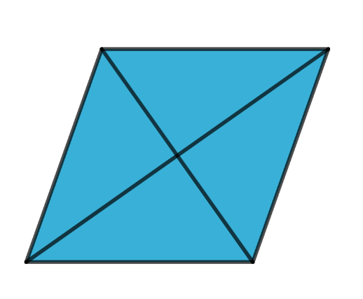
The diagonals of a rhombus can also be used to find its area.
The two diagonals of a rhombus are perpendicular to each other and divide each other in half.
volume 1, pg. 130

Slide 30

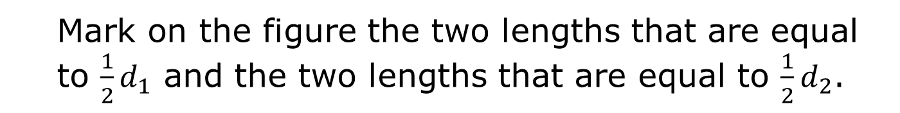



The two diagonals, $d_{1}$ and $d_{2}$, of Rhombus F are drawn and labeled below.
Rhombus F
$$d_{1}$$
$$d_{2}$$
Mark on the figure the two lengths that are equal to $\frac{1}{2}d_{1}$ and the two lengths that are equal to $\frac{1}{2}d_{2}$.
volume 1, pg. 131

Slide 31
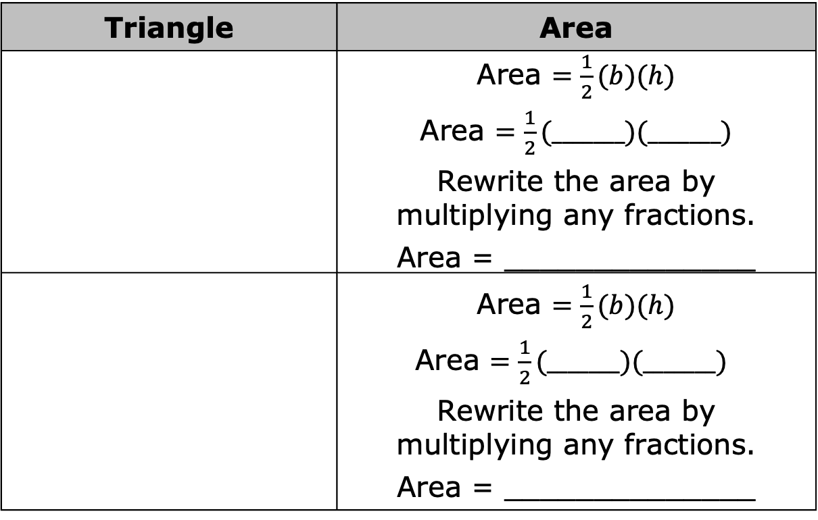
The first column of the table shows Rhombus F with parts highlighted. Use the lengths marked on Rhombus F in the previous question to fill in the blanks to find the area of the triangles.
Triangle | Area
 | Area $=\frac{1}{2}(b)(h)$ Area $=\frac{1}{2}(_______)(_______)$ Rewrite the area by multiplying any fractions. Area = ______________
 | Area $=\frac{1}{2}(b)(h)$ Area $=\frac{1}{2}(_______)(_______)$ Rewrite the area by multiplying any fractions. Area = ______________
Rhombus F
Rhombus F
volume 1, pg. 131

Slide 32
Compare your work with your partner and resolve any differences, if necessary.
Work with your partner to express the area of Rhombus F as the sum of the area of the yellow triangle and the pink triangle found in the table.
Area of Rhombus F = ___________________
volume 1, pg. 131

Slide 33
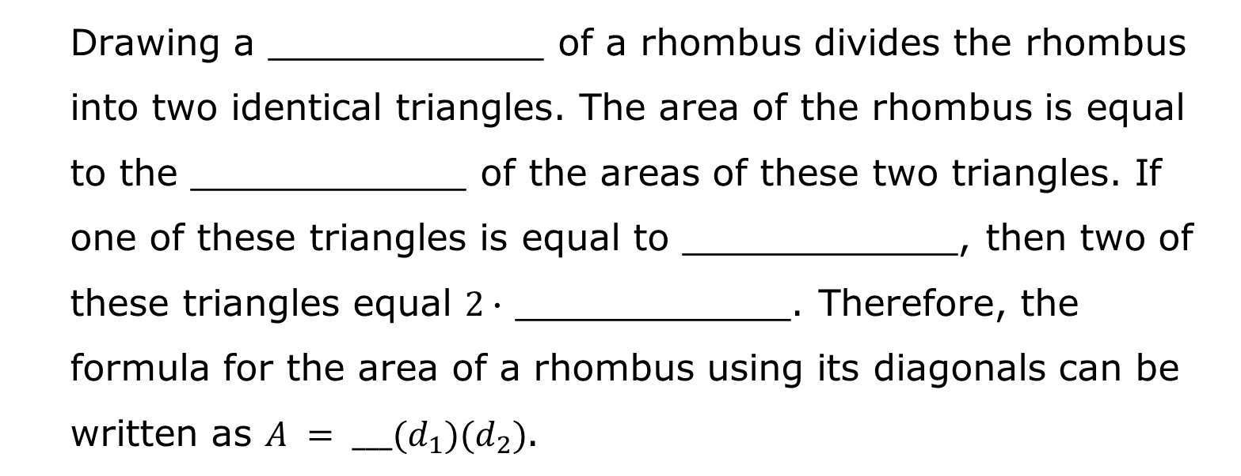
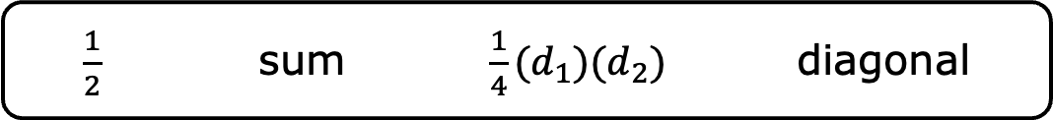
Use words, values, or expressions from the bank shown to complete the statements. Items from the bank may be used more than once.
$\frac{1}{2}$ sum $\frac{1}{4}(d_{1})(d_{2})$ diagonal
Drawing a ____________ of a rhombus divides the rhombus into two identical triangles. The area of the rhombus is equal to the ____________ of the areas of these two triangles. If one of these triangles is equal to ____________, then two of these triangles equal $2∙$ ____________. Therefore, the formula for the area of a rhombus using its diagonals can be written as $A = ___(d_{1})(d_{2})$.
volume 1, pg. 131

Slide 34

Wrap-Up
volume 1, pg. 132

Slide 35

4.1.6 Wrap-Up: Reflection
What was the muddiest (most difficult or confusing) point for you in today’s lesson on deriving the formula of parallelograms, trapezoids, and rhombi?
volume 1, pg. 132

